Slide 1
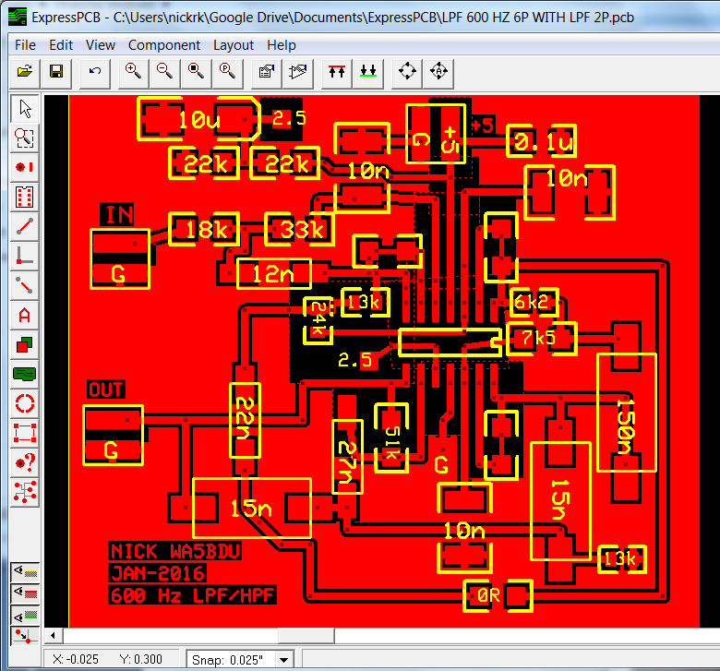
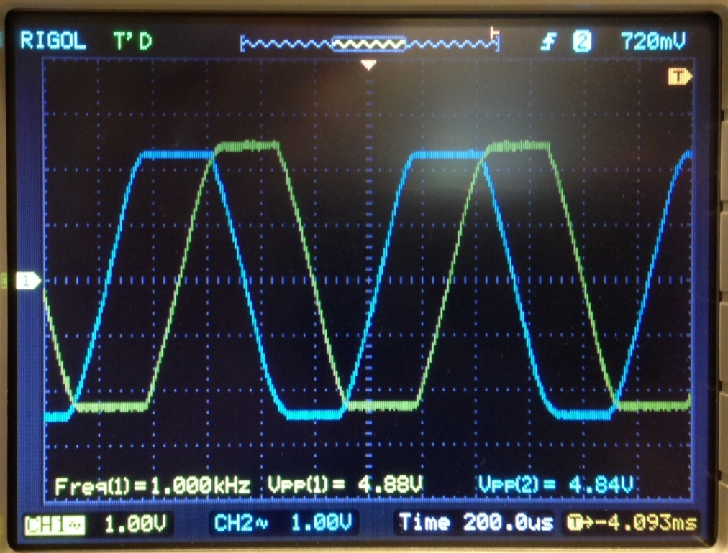
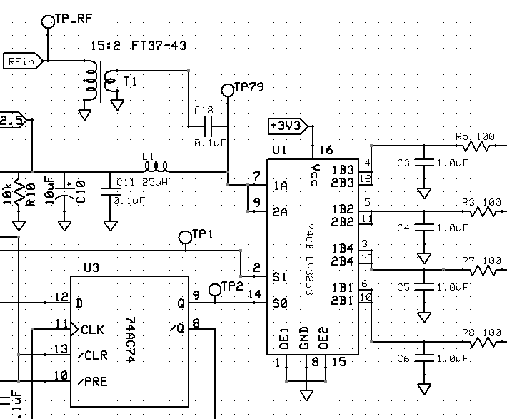
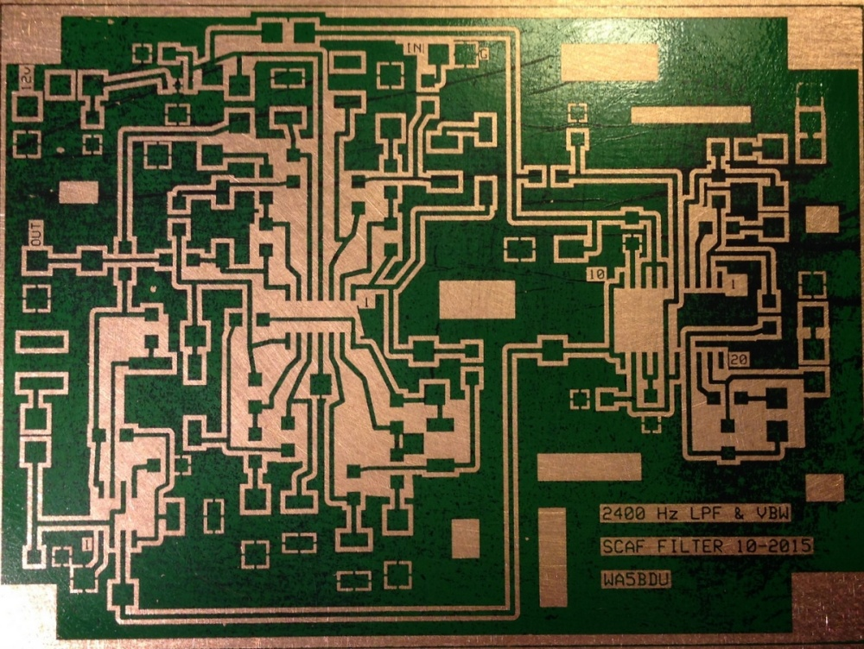
Notes:
This slide will show as I’m getting ready for the talk.
Nothing to say here - the talk begins on the next slide.

Slide 2
Design & construction of a phasing receiver
by Nick Kennedy, WA5BDU
4SQRP’s OzarkCon - April 2, 2016
Branson, MO
Notes:
First, thanks to 4SQRP for having me. It’s an honor to speak to a knowledgeable group like this one.
About me – licensed in 1962, I worked as an EE at a nuclear power plant until finally retiring for good at the end of 2015.

Slide 3
Things to cover in 50 minutes …
What do I mean by “phasing receiver”?
Current proponents and designs
Methods of generating the I & Q signals
Quadrature detector plus DSP or all analog?
Construction – my intro to toner transfer
Design tools – all-pass and selectivity, board layout, circuit analysis (LTspice)
My approach and results
Notes:
Here’s an outline of the things I hope to over in the allotted time.
I’m not presenting an optimized design for users to reproduce, although it is a working receiver. I’m mainly going over the process one would use to design and build a phasing receiver.

Slide 4
Phasing receiver?
Put simply, it’s a direct conversion receiver that uses phasing techniques to eliminate the image or opposite sideband.
There’s a direct mixing to audio at the front end, so the remaining circuits are all audio.
The down conversion gives two audio channels 90 degrees apart. A second 90 degree shift eliminates one sideband and reinforces the other. This may occur in DSP or analog circuits.
Notes:
Back in the 50s and 60s, similar phasing techniques were used to develop SSB for transmitters, notably the Hallicrafters HT37 and Central Electronics 10A.
Regarding DSP versus analog processing, rigs like the K3 and Flex Radio use DSP processing. Recall that Ward Harriman AE6TY gave a presentation on his DSP design and his DSP analysis software here at OzarkCon a few years ago.

Slide 5
Who’s who in phasing receivers?
Rick Campbell KK7B with the R2 & R2Pro and articles in EMRFD and elsewhere. Prefers a single-band, analog approach.
Dan Tayloe N7VE, developer of the Tayloe Detector & designer of the NORCAL NC2030.
Don Huff, W6JL, on the air evangelist for the phasing receiver design. Check out his QRZ page.
Notes:
I didn’t come up with the idea of doing this project in a vacuum – I’m naturally influenced by what other people are doing.
In this slide I want to show some of the guys who inspired me to try a phasing receiver design and whose advice I tried to utilize.
Campbell is a EE professor an prolific author of technical articles for ham radio.
Dan Tayloe’s quadrature mixer using a multiplexer IC gives us a good option for the down-converter stage. He did a presentation on his NC2030 here at OzarkCon one year. He has many tips to offer on low noise, low voltage and low power consumption designs.
Don Huff has built a phasing receiver using a Tayloe detector with an AA0ZZ Si570 VFO and integrated it with a 400 W TX featuring full electronic switched QSK. He can often be found on the CW bands and expresses the thought that this receiver design has a superior “sound” compared with other designs. Although I’m skeptical of such claims, that notion intrigued me. I wanted to hear what it “sounds” like.

Slide 6
Notes:
[DON’T GO INTO DETAIL ON INDIVIDUAL STAGES HERE. KEEP IT SHORT]
Before I can describe the individual stages, I need to show the big picture.
Starting at the lower left, I used an Si570 VFO. I used the strategy in the QEX article by Craig Johnson AA0ZZ to program the Arduino controller. The VFO operates on four times the operating frequency. Note that my Si570 covers about 10 MHz to 160 MHz, so receiver coverage is limited to 2.5 MHz to 40 MHz. No 160.
Flip-flops (74AC74) divide the VFO frequency by four and produce two LO trains, 90 DEG apart.
The Tayloe performs a mixing operation between the RF input from the antenna and the two LO inputs, separately. This gives the two audio output channels I & Q. At this point if you were using DSP, you could send these signals to your sound card or DSP chip.
Note that from this point, we’re dealing strictly in audio, which can be a bit of an advantage in terms of components you can use and construction techniques.
Next comes the all-pass network. It takes two input signals and shifts them 90 degrees with respect to each other. Since they are already 90 degrees apart, this shift will result in them being at either 0 degrees or 180 degrees relative to each other. The two resistors sum the two signals into one.
Note that ahead of the all-pass network is a DPDT switch that can flip which channel from the Tayloe detector goes into what input of the all-pass network. This the sideband select switch.
At this point, we’ve seen the essential “guts” of the phasing receiver. Everything else is dealer’s choice. You need more gain of course, but also you’ll want selectivity – maybe different bandwidths. You may want AGC or audio clipping. You can decide if just earphone or line ouput is sufficient, or you could include a power amplifier for a loudspeaker.

Slide 7


A tiny bit of theory
LO > RF
RF > LO
Notes:
I just want to give the briefest introduction to how and why this all works.
There’s a signal on 7040 kHz. I tune my VFO to 7040.5 kHz. When I mix these signals in my detector, I get 500 Hz out. But I mixed them twice, with two LO signals 90 degrees apart, so I get two 500 Hz tones.
[ANIMATE LEFT SIGNALS ON]This simple diagram called a phasor diagram is intended to show the signals’ amplitudes indicated by the length of the line, and their relative phase which is of course shown by the angle between them. Here, Q lags I by 90 degrees and the amplitudes are identical.
Note that there have been published designs called “binaural” receivers that stop here and feed one signal to each ear.
But we apply one of these signals to each input of the all-pass network. That network functions to shift both I & Q in phase such that the total shift between the two totals 90 degrees. In addition to whatever phase difference already existed, of course.
[ANIMATE TWO SHIFT ARROWS]
The curved arrows show what the all-pass network does. Note that I is being rotated CCW and Q is being rotated CW. With their rotations totaling 90 degrees, we can see that the phasors will end up in-line (180 degrees apart) and so opposing each other. If added, they’ll cancel.
[ANIMATE RIGHT SIDE I & Q PHASORS]
Getting back to the original scenario, suppose I tuned my VFO to 7039.5 kHz instead of 7040.5 kHz? I still produce two 500 Hz tones, but look at the change in phase relationship. Now Q leads I. This is really where all the magic happens. [ANIMATE RIGHT SIDE SHIFT ARROWS] Note carefully that the all-pass network is doing the exact same thing it did on the left, that is I is being shifted CCW and Q is being shifted CW. But in this case we can see that the net result is that the phasors are moved toward each other and wind up in phase and reinforcing.
To summarize, the action of the all-phase network will cause two quadrature signals to either cancel or reinforce based on whether Q leads or lags I. And leading or lagging depends on which side of zero beat the LO (VFO) is tuned to.

Slide 8
Notes:
I’ll page through the schematics and make comments about key points, but obviously they’re too complicated to cover in detail. I’d like to cover some tips I picked up from the experts, things I learned, mistakes I made and so forth.
This is the front end of the receiver. See the Si570 signal coming in at the left. Its output is about 3 Vpp, which should be enough swing to clock 3.3 V logic chips. I’ve seen various schemes to convert the bipolar input to single ended, but I used the simple method of a voltage divider to add 1.65 VDC to the input. Another possibility was just to omit the coupling capacitor coming out of the Si570.
The two 74AC74 flip-flops even out the duty cycle and create the 90 degree phase shift. Note that I originally used 74HC74 but learned that the AC family is faster. Those phase shifted signals act like addressing inputs for S0 and S1 of the ‘3253 MUX chip. Each of the four possible states enables a path from the ‘A’ inputs to one of the four ‘B’ outputs. This is how the mixing or sampling works. The antenna connects that the top center “RF in”.
Here note that the receiver is a “single supply” design, so the signals generally ride on Vdd/2 or 2.5 V. This can cause complications in the design of some stages. Here I have a voltage divider from 5 V to 2.5 V connected to the same input as the antenna through a 25 uH choke. This voltage carries though the MUX and on to subsequent stages so long as they remain DC coupled.
The four capacitors on the outputs of the MUX integrate up the chopped up samples and give the audio output. Note that there’s a lot of flexibility in the size of them. I used 1.0 uF because I had a bunch of high quality film caps I could match closely. Also note that the Tayloe detector has a lowpass characteristic. That might be good or bad but note that Softrocks use a much smaller capacitor here, probably to give the extended BW required. The op-amps serve as both part of the integrators and as gain stages. In fact, they provide about 36 dB gain. It’s good to get your signal out of the dirt early.
I decided to use film or poly capacitor type in the signal path even if I had to deviate from SMT to do so. It’s hard to find quality SMT capacitors above 0.01 uF. (I consider NP0/COG to be OK.)
At the bottom of the page are two op-amps configured to give phase and amplitude adjustment capability to correct for small errors and allow nulling of the opposite sideband.
Finally you see the sideband select relay. In hindsight, just a DPDT toggle switch would have been simpler and just as good.

Slide 9
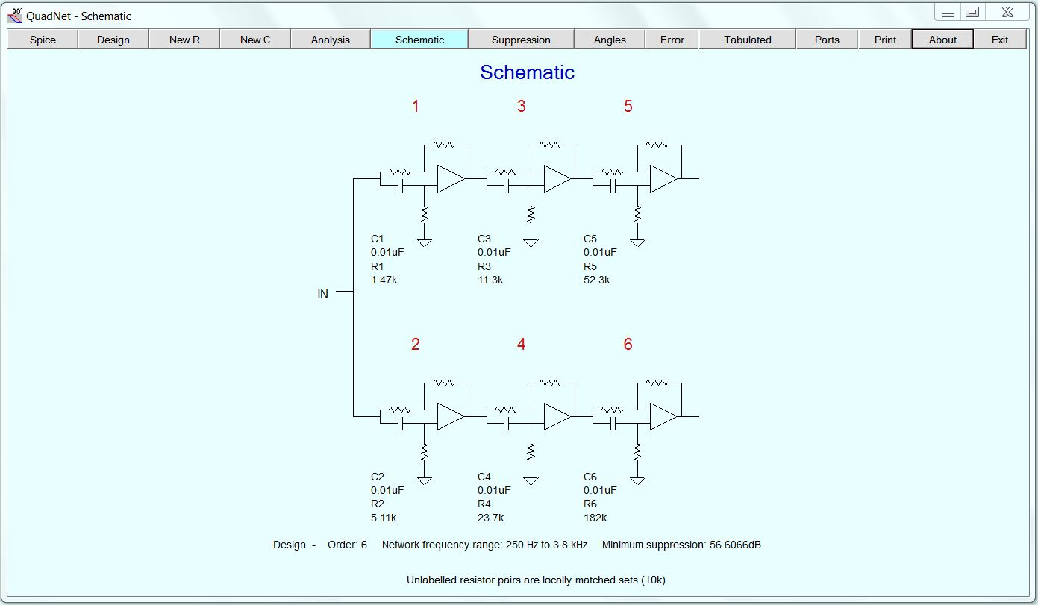
All-pass network
QuadNet by TonneSoftware.com
Notes:
[SHOW BRIEFLY, THEN GO TO NEXT SLIDE TO DISCUSS FEATURES, GO BACK AND FORTH]
Designing these networks is not trivial, so I start with a slide of an excellent free program that can do it for you.
Go to next slide for discussion points and return here to show some of them. (QuadNet by Tonnesoftware)

Slide 10
All-pass network
QuadNet will do the design or analyze your design and output the circuit for LTspice to pick up
You can multiply C’s and divide R’s by the same number to scale to your in-stock components
You can also swap the shunt R and series C positions of QuadNet, to work better with single supply design
With more sections than shown, you reach diminishing results due to required tolerances. Use precision R and measure capacitors, model actual values to predict actual performance.
Notes:
I eventually used the network from R2Pro and EMRFD figure 9.69, scaled to 0.1 uF capacitors I had on hand. If you can get 50 dB opposite sideband suppression, you’ve done pretty well.
Flip back to the previous slide to show the components I’m talking about for scaling and swapping.
Mention that the next slide will show my actual circuit.
I’ve seen designs with both four and six op-amp sections.

Slide 11
Notes:
Here we see my actual circuit, which takes up one dedicated board.
Note how the C and R positions are interchanged. Also notice that I entered as-measured values of capacitance, measured with my AADE instrument.
I also show a buffer amplifier with volume control and I used the extra op-amp section to put my first of two HPFs into the chain. I have many poles of lowpass filtering, but felt the need for some highpass filtering as well. Partly for 60 Hz and harmonics and partly to give me some selectivity on the low end.
I provided a couple of AC coupled outputs in case I want to connect them to soundcard software or whatever.
I used mostly quad TLV2464 op-amps in the receiver as they have the low noise characteristic I want, plus can drive a fair mount of current and can also operate OK with a 5 V or 3.3 V single supply. The quad configuration causes some crowding in my SMT board, but the per amplifier cost is cheaper and cheap rules!
Mention that the next slide shows the phase shift between the two outputs of the network.

Slide 12
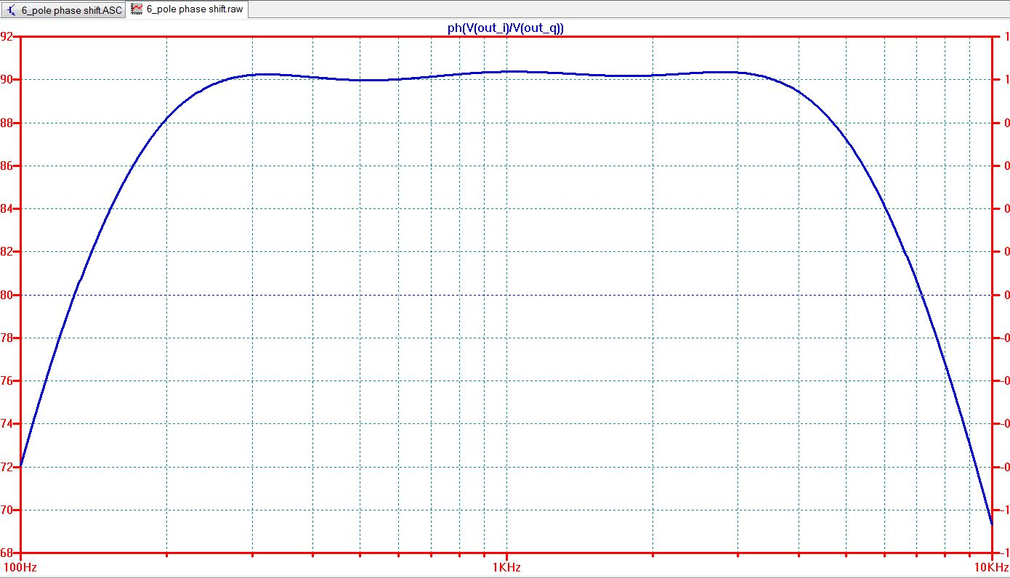
Phase shift from all-pass network
Notes:
This plot was done by LTspice. You can plot the phase difference between two signals by plotting their ratio and using the ph() function to plot phase instead of magnitude. See my formula on the top bar: ph(V(out_I)/V(out_Q))
First, this shape seems familiar, right? It looks like the magnitude response of a bandpass filter. But we need to interpret this a little differently. Left and right of the flat-topped portion of the curve, it slopes down. Which reminds us of attenuation of signals out of the pass band. But we’re actually seeing regions where attenuation of the opposite sideband is degrading.
The phase difference of the flat-top region is very close to 90 degrees so this is where we get good image rejection.
So that helps answer the question: Why did Rick Campbell design the network of a CW receiver to have a range of about 300 to 3000 Hz? Because that’s the range over which we get good image rejection.
What about below 300 Hz and above 3000 Hz? That’s where this network has to work in tandem with our conventional amplitude filters: lowpass, highpass and bandpass. Their response curves with good slopes need to fit well inside this curve. So when the demodulated frequency is outside the region of good image response, it will be attenuated by being outside the slopes of our conventional audio filters.

Slide 13
Filters & Gain
Tools like TI’s FilterPro simplify the filter design process
Experts say keep Q and group delay low to avoid ringing
An end-to-end gain of about 100 dB is a typical goal for the entire receiver. That would raise 1 uV at the antenna to
100 mV at the phones.
I opted for a 2400 Hz 8-pole lowpass filter that’s always in line and a 600 Hz 6-pole lowpass filter for CW that can be switched to be in series with the 8-pole filter.
A SCAF filter with tunable BW and center frequency would also be a good option.
Notes:
FilterPro is a good desktop tool and Analog Design has a nice on-line filter design tool.
FilterPro will show stage Qs and both FilterPro and LTspice will show group delay.
Actually, my initial design include a SCAF mostly taken from the NEScaf, but I had some noise issues I couldn’t tame so I went to the LPF instead.
(Q<3 and group delay < 1.8 ms is one recommendation.)

Slide 14
Notes:
In this slide you see my 8-pole 2400 Hz LPF at the top and the 6-pole 600 Hz narrow filter below.
I also added an additional 2-pole HPF to help with roll-off on the low side.
Notice how the DC (resistive) coupling helps with the single-supply issue of keeping 2.5 VDC to center the signal. And at the lower left, the capacitively coupled HPF breaks that chain, necessitating a Vcc/2 divider for biasing. Also note the 22 uF blocking capacitors on the upper filter. These stages need to have a DC gain of one but an AC gain as required.
The DPDT switch adds the narrow filter in series when desired. That filter needs a gain of one since we don’t want the gain changing as we switch filters.
Note an “error” in which the HPF is switched out with the 600 Hz LPF. That actually occurred as part of a design evolution where the 600 Hz filter is on a small sub-board replacing the SCAF filter. I had an extra op-amp section and used it for an HPF stage. If I started this board from scratch, all these filter stages would be on one board and the HPF would be always in line.

Slide 15
Notes:
Here are response plots from LTspice of the wide (2400 Hz LPF) filter (RED) and the narrow (600 Hz) and wide filters in series (GREEN). Note where the green line turns down more sharply when it combines with the wide filter at 2400 Hz.
Also, the green line includes the 300 Hz HPF as well.
I like to listen to a CW note of around 400 to 550 Hz.

Slide 16
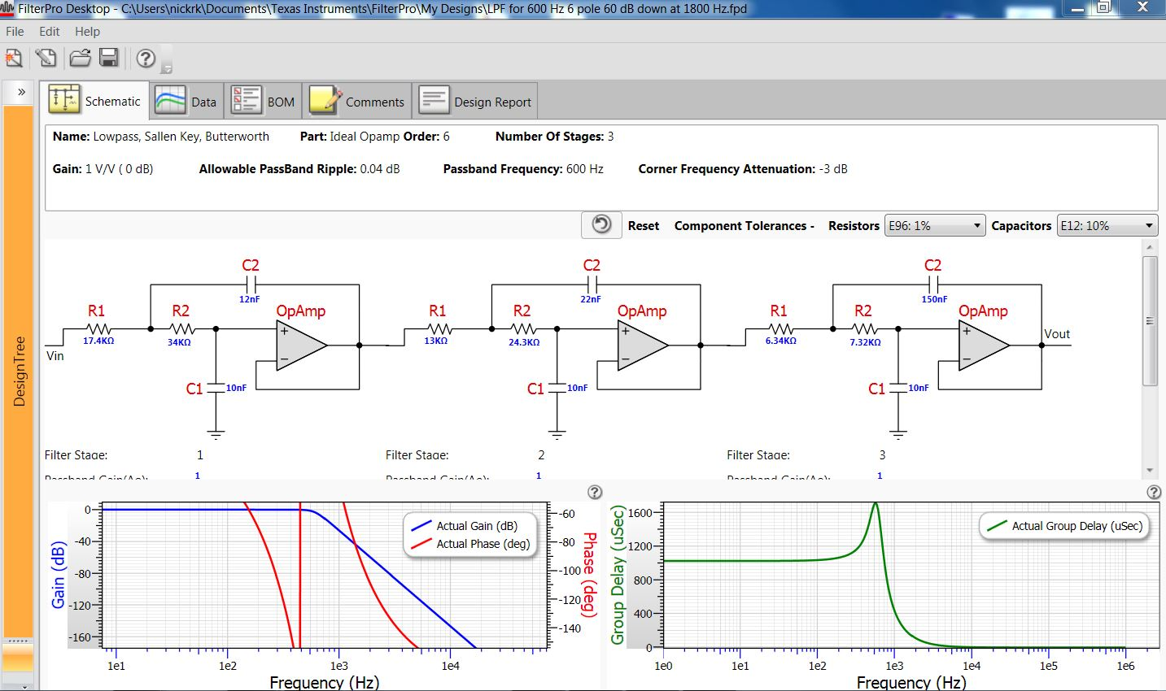
FilterPro
Notes:
Here’s a shot of a screen from FilterPro. Earlier, you got to choose the filter type, number of stages and so forth. Here we see the results. The schematic is shown with Q and gain for each stage, plus the total response and group delay. You can also choose what precision you want for the resistors and capacitors (separately) and therefore get results for real off the shelf components.
I don’t usually buy or find in my junkbox many precision capacitors, but I do like to buy in quantity and measure and match them. One percent SMT resistors are fairly inexpensive these days so I don’t mind using them.

Slide 17
Gain table
Stage | Gain | Notes
RF preamplifier |  | None yet
Tayloe detector | 36 dB
Post detector gain stage (HPF) | 13 dB | Removed
Phase adjustment | 6 dB
All-pass networks | 0 dB
High-pass filter | 12 dB | Measured here 56 dB
Gain stage | 6 dB | Was 20 dB, reduced …
Low-pass filter 2400 Hz | 12 dB
AN6123 AGC or op-amp | 24 dB | Here: 96 less preamp
Audio power amplifier | 0 dB followers for phones, 12 dB gain speaker amplifier
Notes:
Just an example of using a table to keep track of gains (and losses as applicable)

Slide 18
Notes:
Here’s the final board. It contains an AGC chip that can be switched out in favor of a linear amplifier with the same gain. There’s also a simple 6 dB gain stage I put into service when I decided the receiver needed some more gain and I had a spare op-amp on this board.
There are separate unity gain output amplifiers for the Left and Right earphones. The reason for having two is this – if you combine earbuds in parallel, their resistance is a bit low for an op-amp to drive. But if you connect them in series, they will be driven out of phase and some listeners might be able to sense this as undesirable. So a separate op-amp is provided for each earbud. Note that an op-amp with decent output current capacity can drive earbuds just fine – a specialized audio amplifier isn’t needed as Dan Tayloe likes to remind us.
But for an 8-ohm loudspeaker, things are different. I chose a low distortion BTL coupled audio amplifier capable of one watt into 8 ohms. Note that with the BTL output, neither side of the speaker jack can be at ground! I found that even hooking up my oscilloscope ground clip through a capacitor made the amplifier unhappy.
Note that if the AGC path is not selected, the alternate amplifier can have limiting / clipping diodes in its feedback as an “ear saver” measure. The AN6123 AGC chip limits nicely without distorting the sine wave and also gives 24 dB gain. So of course the alternate linear amp also needs 24 dB gain so there’s no “bump” when switching between the two.
I’ve put separate regulators on all my main boards. In this case, I used a full sized 7805 regulator and provided wider traces from it to the TPA4861 audio amplifier.
Recall that the volume control appeared way back after the all-pass network. Dan Tayloe suggests that the volume control should be placed about halfway up your gain chain – in this case after about the first 50 dB of gain.

Slide 19
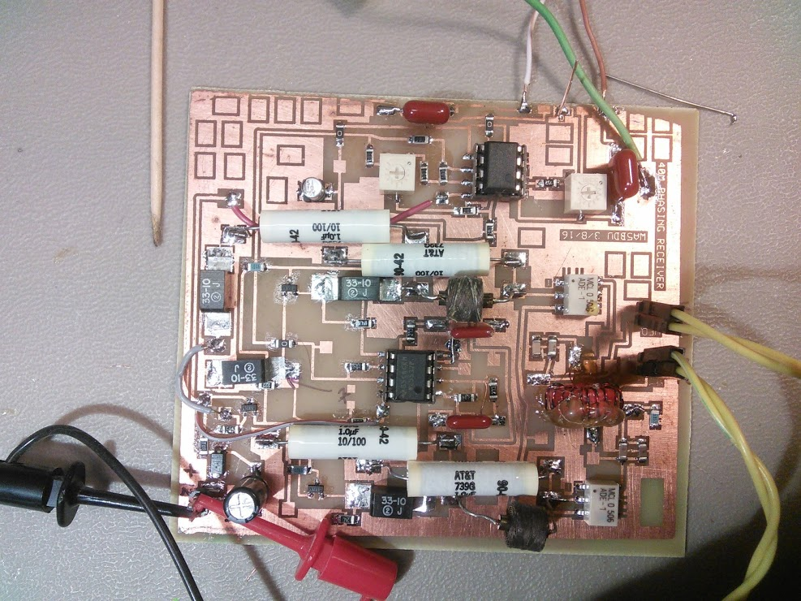
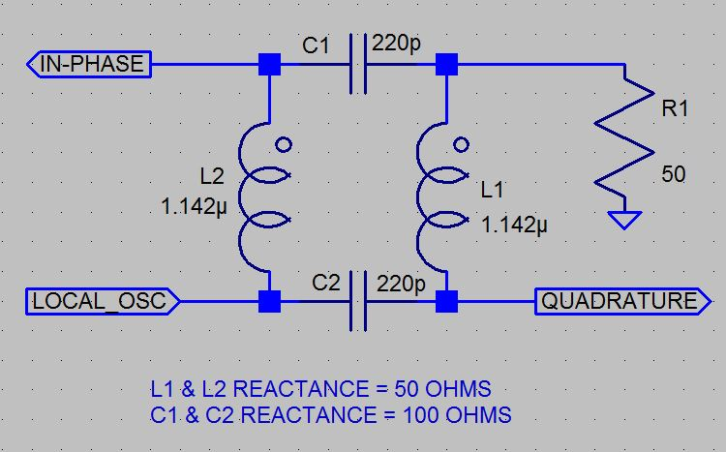
Another phase shifting technique
Notes:
NOTE: Animation, click for left image, then for right.
(Left) This simple network will take the signal from the VFO or local oscillator and split it into two quadrature signals (meaning separated by 90 degrees).
The two inductors are bifilar windings on an iron core toroid (T50-2 in this case). To achieve the phase shift, the windings have a reactance of 50 ohms each and the two capacitors have reactances of 100 ohms each.
Obviously then, this circuit works at a specific frequency. In practice, the phase shift can be reasonably accurate over an entire ham band. In this case, 40 meters.
To test this technique, I had to add a lot more components, finally borrowing much of the circuitry from the MicroR2 by KK7B.
[Click animation to show photo at right]
Show with the Laser pointer the toroid and capacitors in the lower right corner, then mention the two ADE-1 DBMs and the 2N3904 common base amps and two NE5532 op-amps for tweaking and amplification stages.
Is this method simpler? Not really. You might prefer it for aesthetic reasons – analog over digital. Or you might prefer to have a VFO that runs on the operating frequency instead of at four times the frequency.

Slide 20
Notes:
Here’s a quick look at that 40 meter I/Q front end using the twisted wire phase shifting network.
Show:
Network,
Two ADE-1 DBMs
LPFs and common base amplifiers
Post amplifiers
Phase & amplitude tweaking stages
Note for an input I used an AD9834 DDS sold by W8DIZ having about 14 dBm output

Slide 21
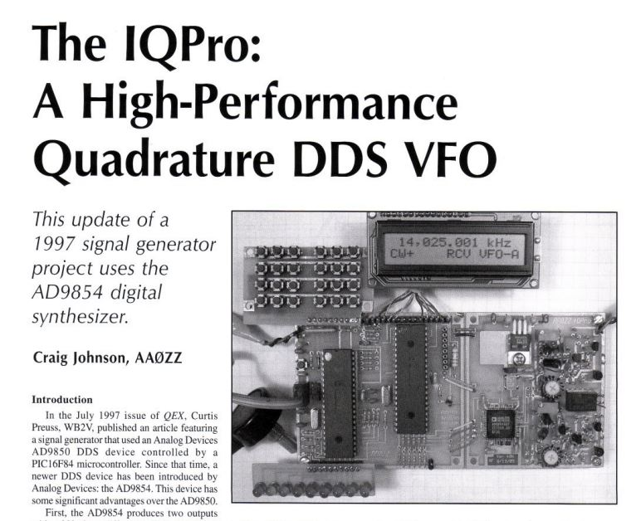
DDS chip with quadrature outputs
Notes:
And here is yet another way to generate your quadrature LO signals. The AD9854 DDS chip has two quadrature outputs, as described in this article by Craig Johnson AA0ZZ in the May-June QEX article.

Slide 22
Toner transfer board fab
Allowed me to increase the complexity of my projects
I started with K7QO’s Muppet videos on YouTube
Requires a Laser printer ($60) laminator ($50 - $100)
I use the special fab-in-a-box paper, but others use regular photo paper. The process works great!
ExpressPCB is the software of choice to produce the layout
I have a personal preference for SMT over leaded. Size 1206 or 0805 parts and SOIC aren’t hard.
Notes:
Why am I veering away from my receiver design talk to discuss board fabrication? Because for me, it allowed doing projects that were more complex. I lack the discipline or vision to do them in Manhattan or Ugly styles. This method forces some discipline on me as I want to have things right the first time if possible when I’m doing a board.
Also, for prototype work, I much prefer either Manhattan or SMT as they allow rework easily. No through-hole except for proven designs!

Slide 23
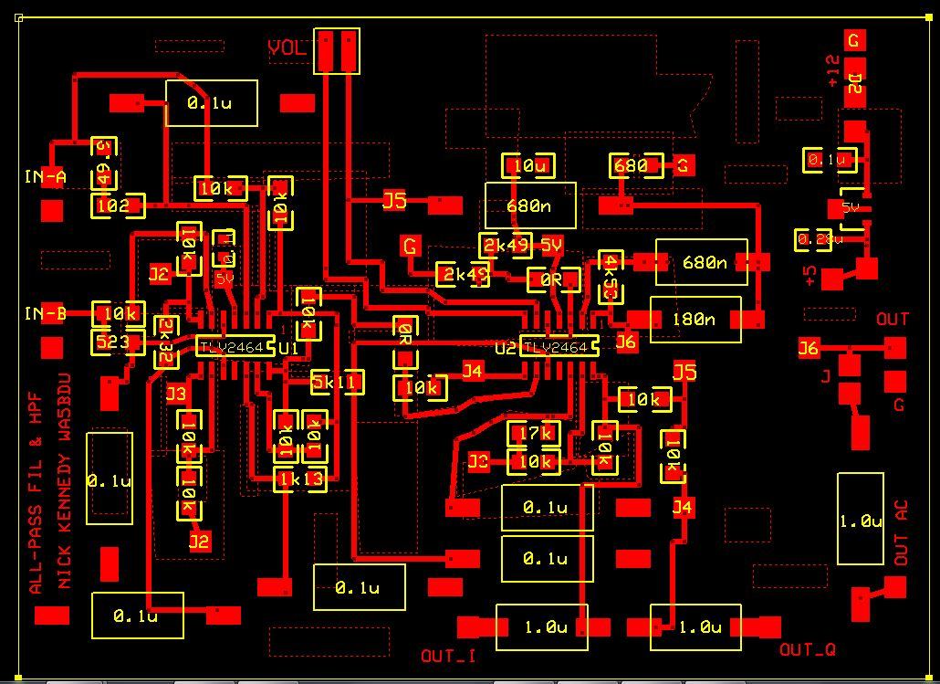
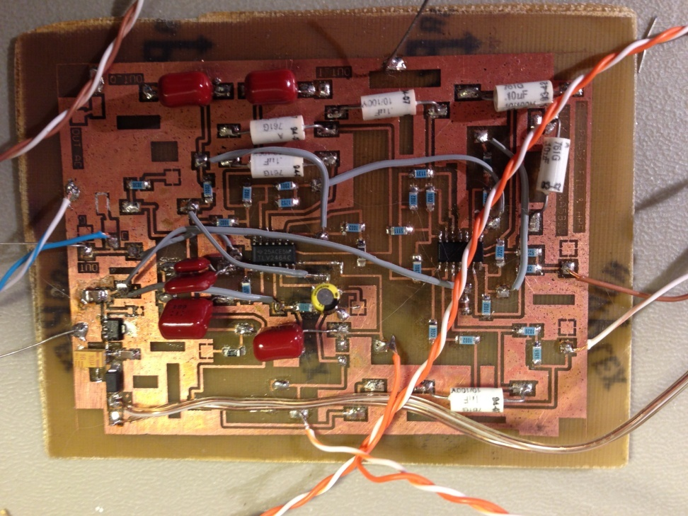
From design to physical …
Notes:
This is the all-pass board.
The yellow markings are for my info. Note the use of conventional leaded components. As I said, I wanted to use quality capacitors. I use ExpressPCB to make footprints for them. On the left, you don’t see the “pour” of ground plane fill surrounding everything. I generally do use that, then use “keep out” regions where I don’t want the ground plane crowding in.
I’d like fewer jumpers, but I only make single sided boards to date.

Slide 24
Design trade-offs, missing bits and other notes
This design allows for all band (80-10) coverage, but requires the 4x VFO
What about a preamp? Sensitivity is good as-is, but I agree a switchable preamp would be helpful at times and do expect to try some designs. Maybe an attenuator too.
Where’s the front-end filtering? The Tayloe detector has very high overload tolerance. I’ve heard a bit of AM-BC and SW-BC breakthrough at times, with my boards exposed on the bench. But not bad overall. I have used an external HPF for a local AM station on 610 kHz.
Well, how does it sound? It sounds great to me. Mostly the absence of ringing. I have some background hiss, especially in the wide BW position. More tweaking could reduce that.
Notes:
The analog shifting designs are by nature single band – unless different shifting networks are used for each band.
Rick Campbell credits his JFET preamp for reverse isolation and it also has a muting function, as well as added gain.

